Slide 1


Meeting App with Configurable Tab (Extended lab)

Slide 2

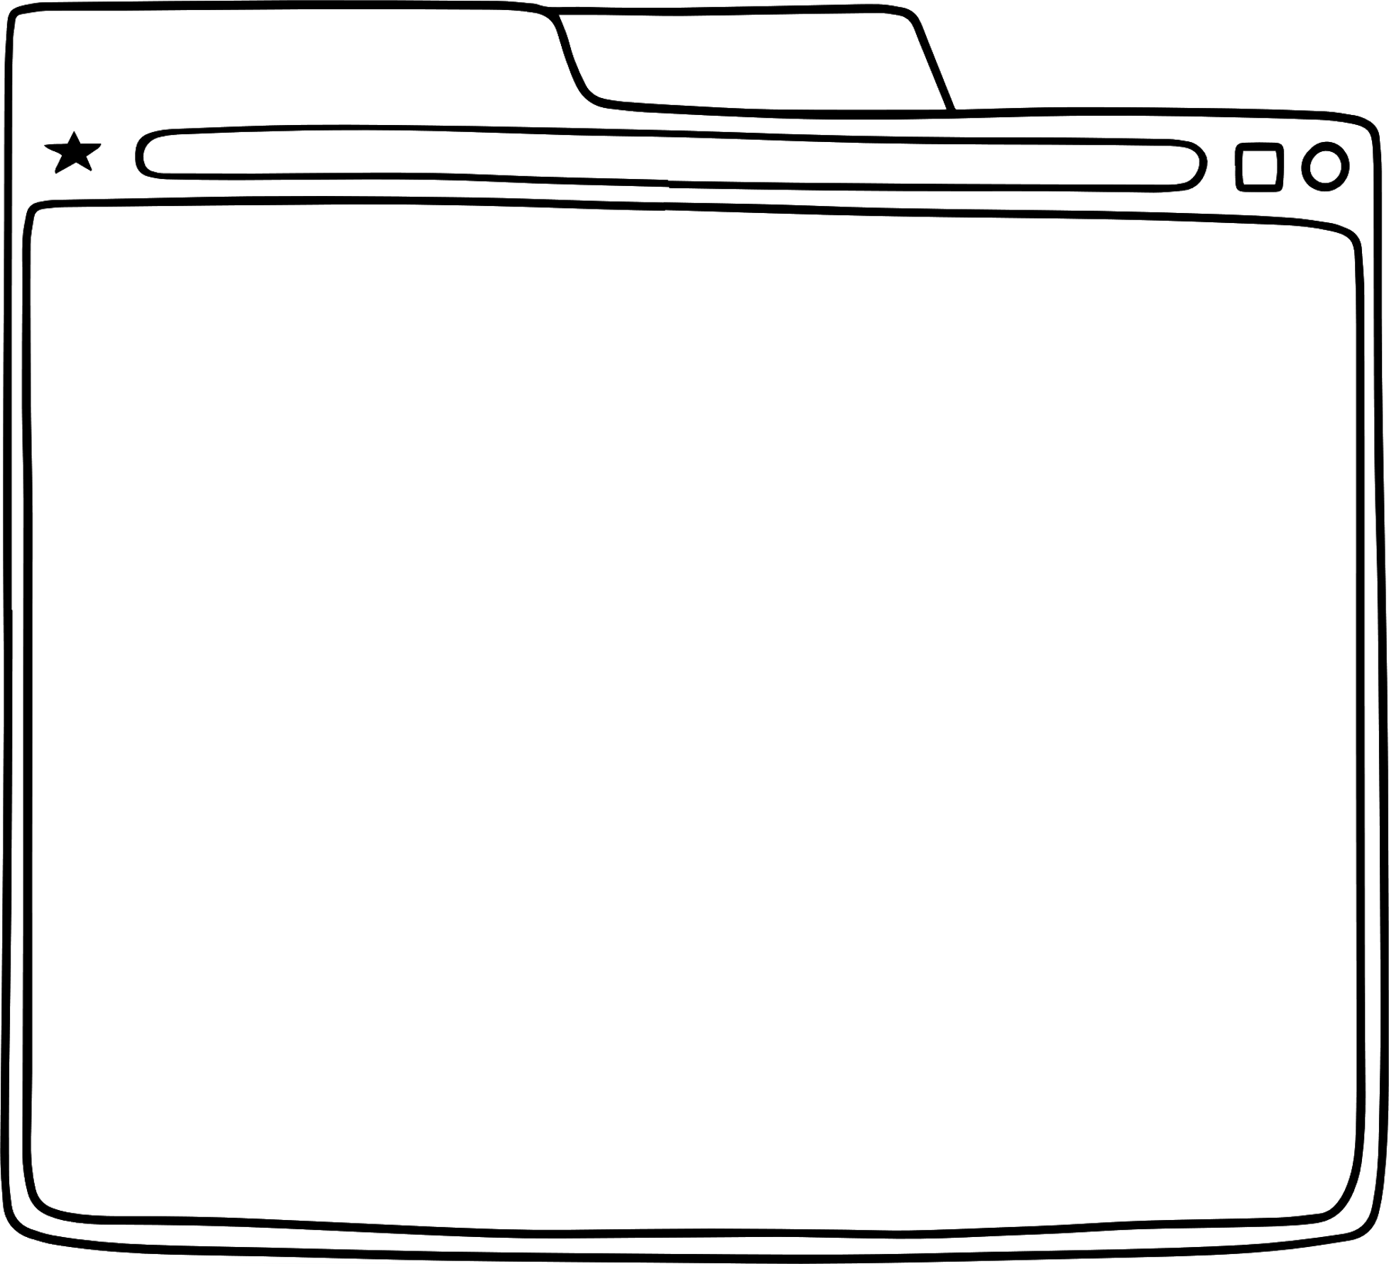



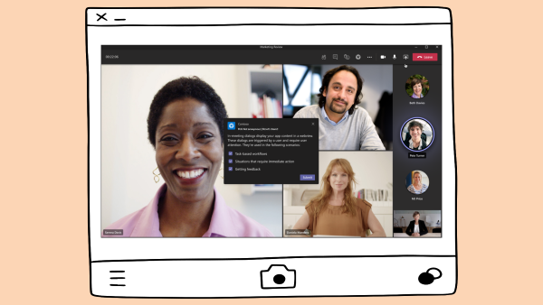
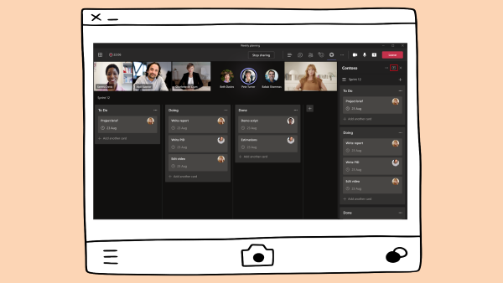
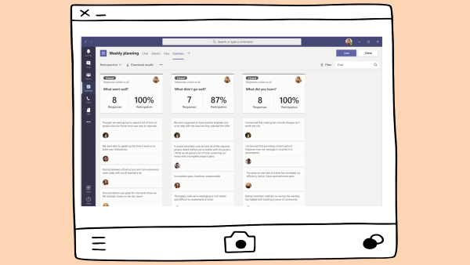



Meeting App
Deliver your app experience at each stage of the meeting lifecycle: pre / in / post-meeting

Slide 3




Lab Structure
Core Lab (path A)
App setup
Add tab with SSO
Add look and feel
Migrate an Azure AD Web App to Teams
start
Personal tab with
Azure AD SSO
Core Teams Application
Configurable
tab
Deeplinks
Dialog
Message Extension w/Adaptive Cards
Monetization
Meeting App
Extend capabilities
Notes:
Point out that that students must complete the Configurable tab lab BEFORE beginning the Meeting App lab.

Slide 4
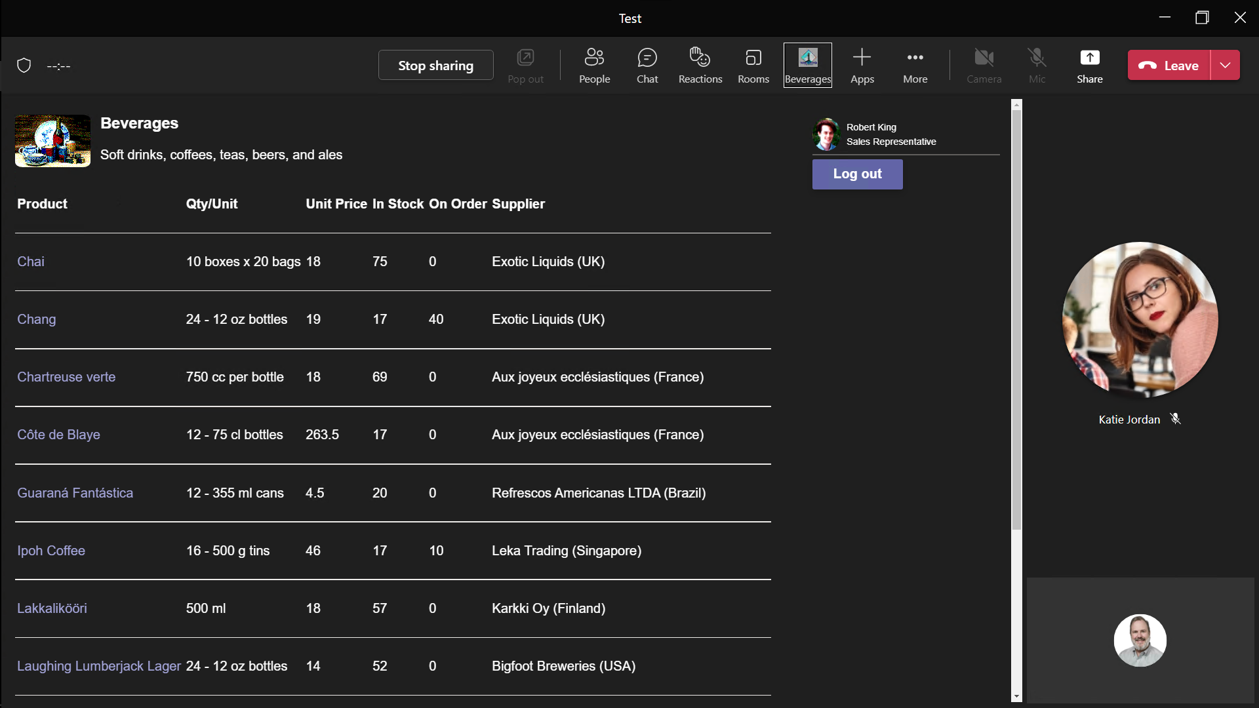
Meeting Apps
Tabs and bots are available before, during, after a meeting
Allow users to use the app collaboratively as they meet
Collaboration
Discoverability
Organizer installs the app for everyone in the meeting
Users can configure shared tabs and interact with chat bots
Users can meet and chat alongside the application
Provide information and capture outcomes during meetings
Notes:
Suggested demo: Show the completed Meeting Apps lab

Slide 5
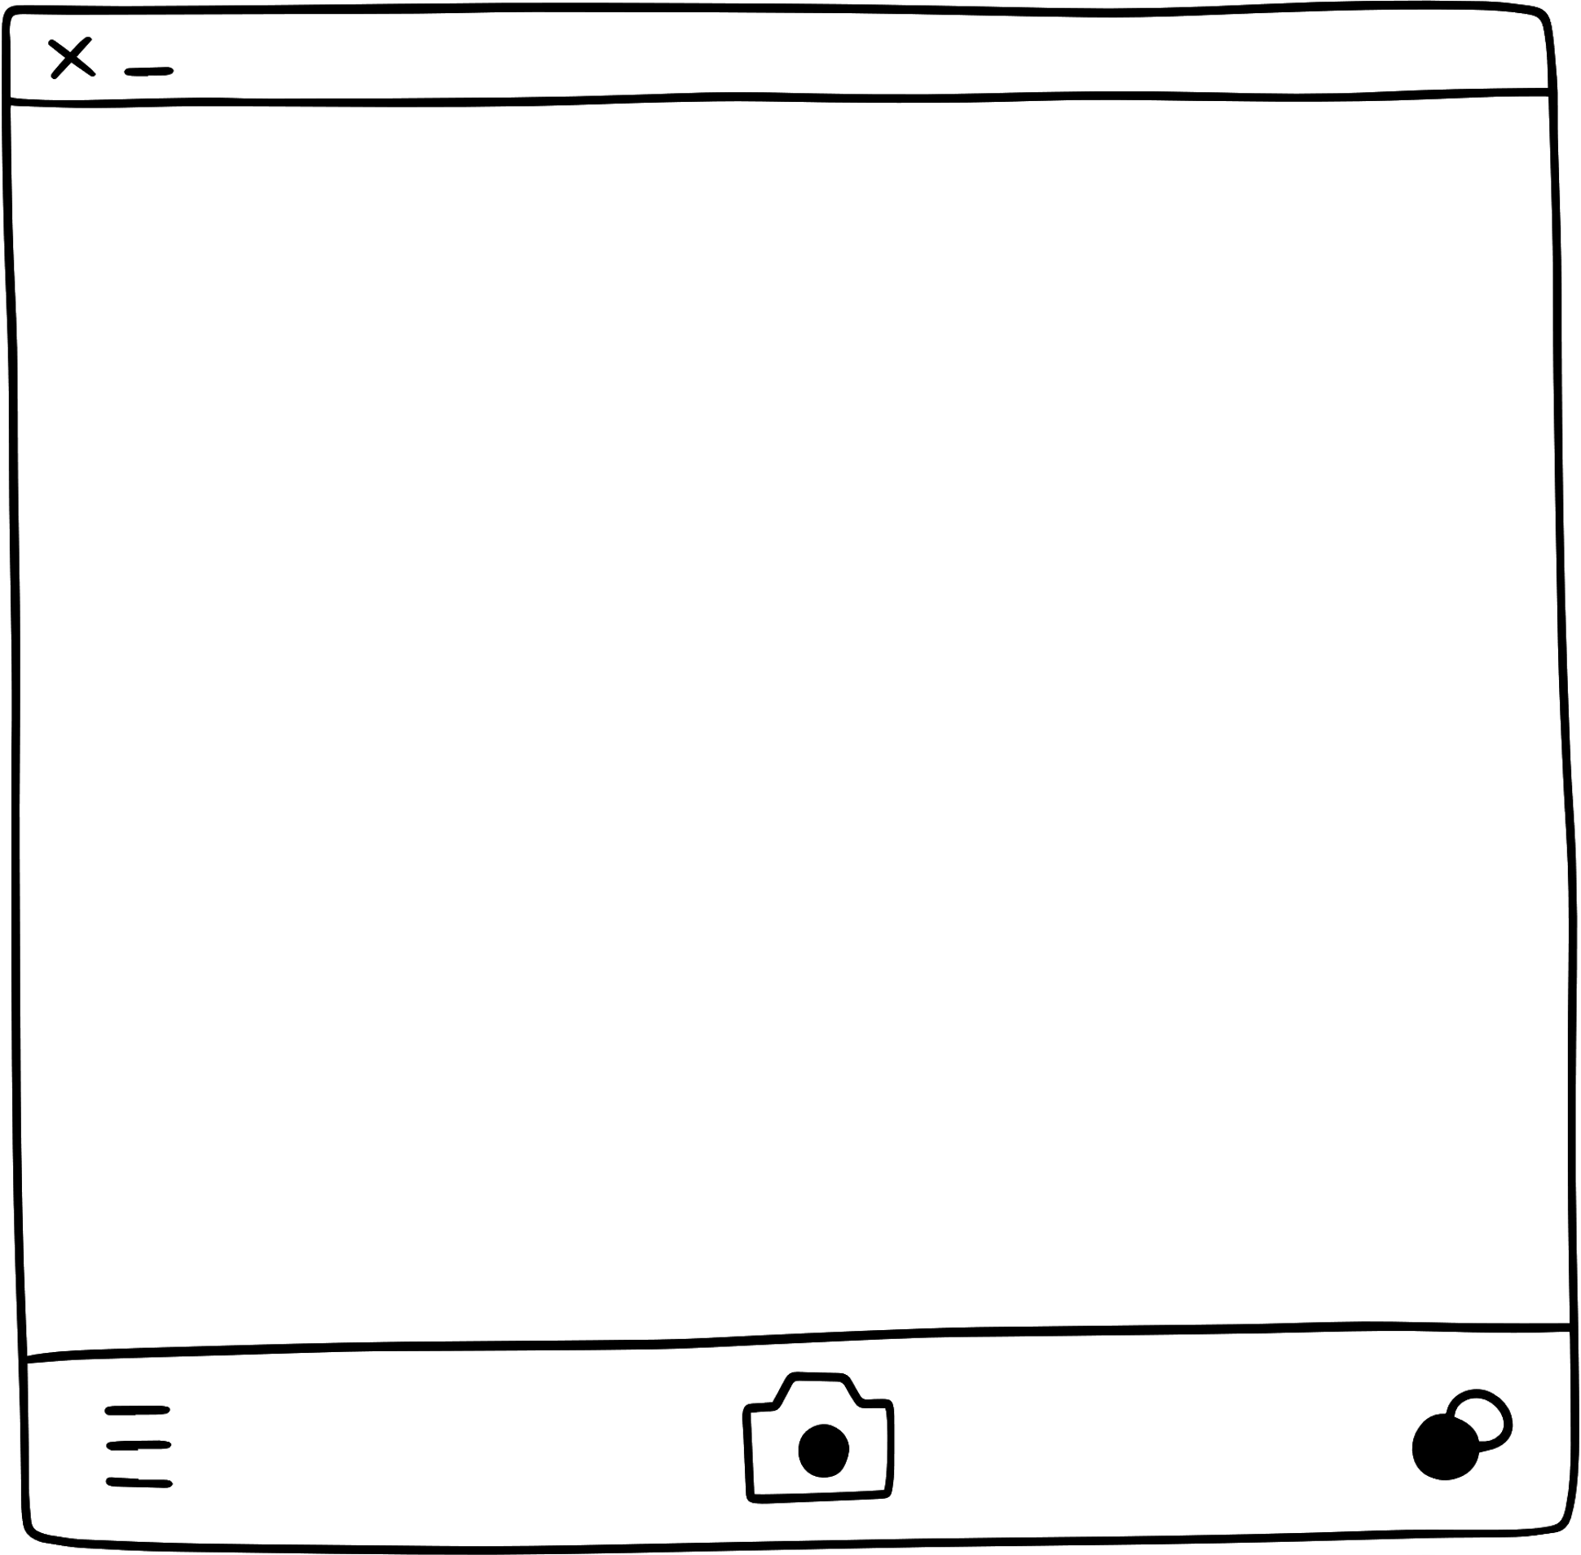
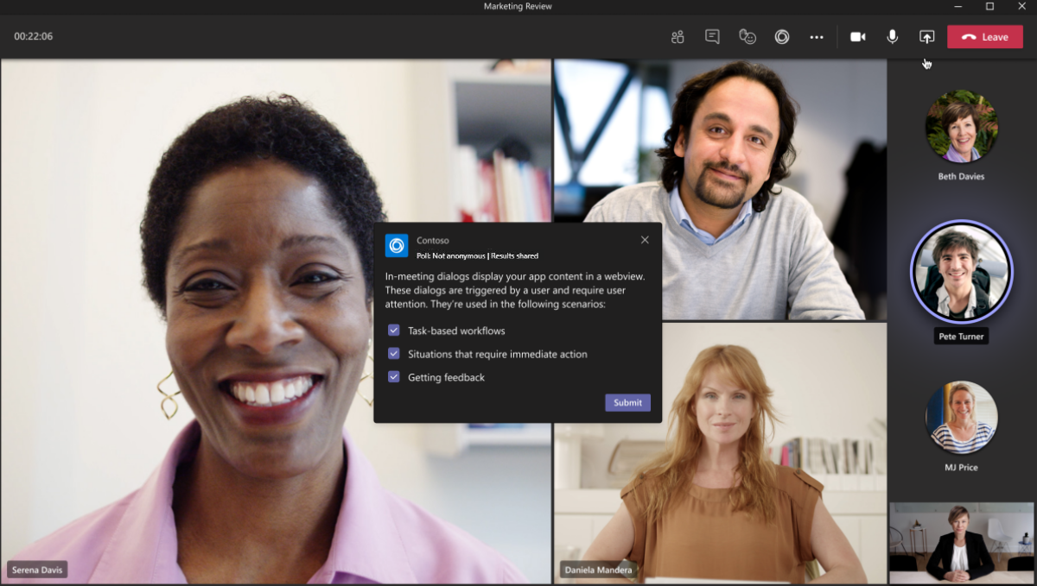

Slide 6
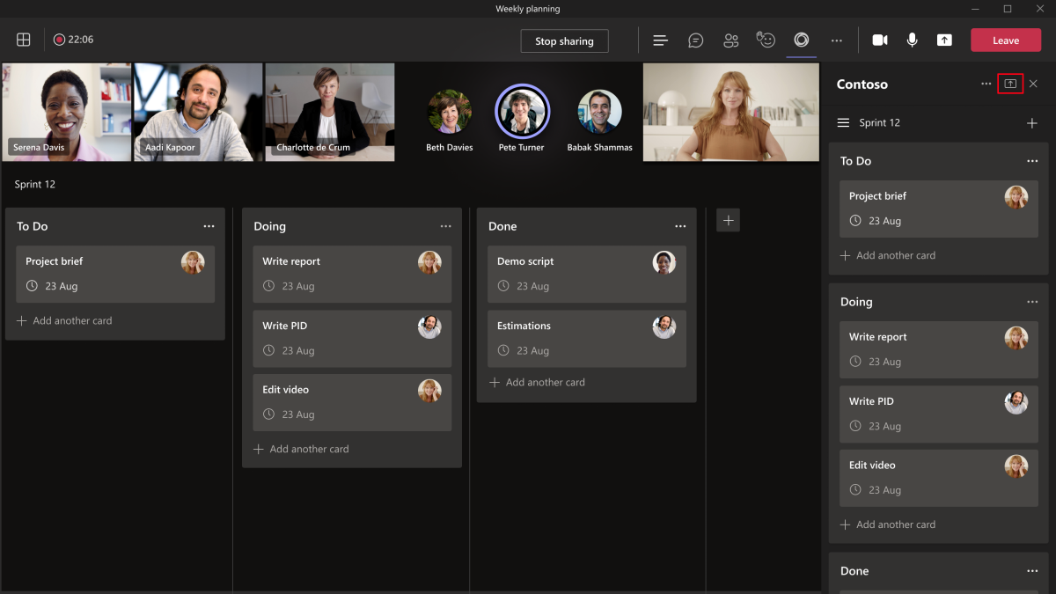

Slide 7
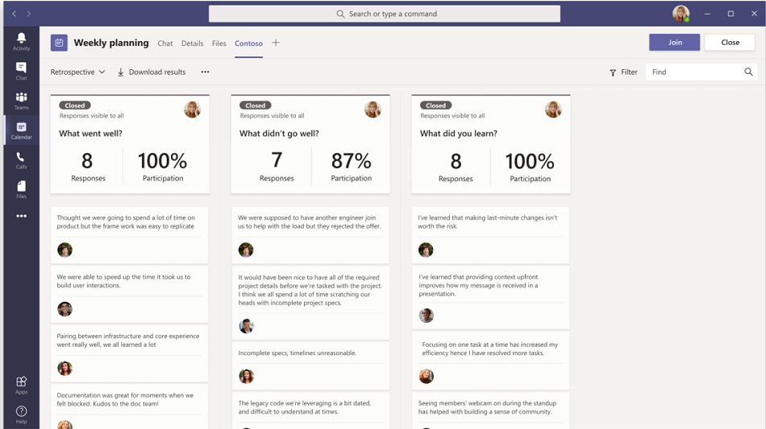

Slide 8
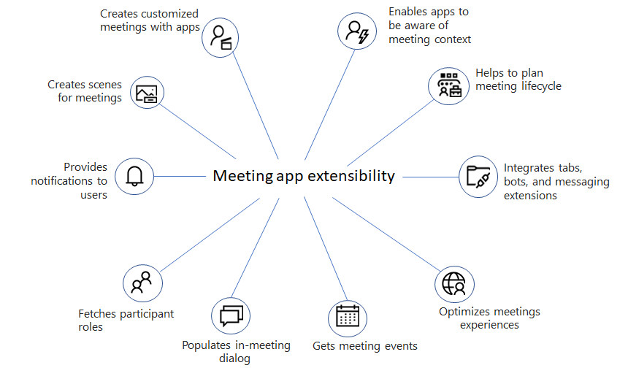
What’s specific to building meeting apps?
1. Enable your app to run inside a Teams meeting
2. Use Teams SDK 2.0 to activate the meeting extensibility features
"configurableTabs": [
{
"configurationUrl":"https://<HOST_NAME>/tabConfig.html",
"canUpdateConfiguration": true,
"scopes": [ "teams", "groupchat" ],
"context": [
"meetingChatTab",
"meetingDetailsTab",
"meetingSidePanel",
"meetingStage"
]
}
]
Check that the app is running in the side panel
>const { page } = await microsoftTeams.app.getContext();
>page.frameContext === microsoftTeams.FrameContexts.sidePanel;
Check that if the app is shared in the neeting stage view
>microsoftTeams.meeting.getAppContentStageSharingState();
Notes:
Explain how the Teams app manifest is updated to declare the meeting app capability
Describes the meeting app capabilities
Focus on the 2 methods of the Teams client SDK we’ll use during the lab

Slide 9

demo
Notes:
Lab demonstration:
- Set up a meeting with another test user and add the app
- Show the app running in Sidebar and Stage view
- Review the changes in the app manifest

Slide 10
LAB TIME https://aka.ms/app-camp Please do Meeting app lab
Notes:
Note there is a video for each lab showing a complete walk-through

Slide 11
Lab Structure
Core Lab (path A)
App setup
Add tab with SSO
Add look and feel
Migrate an Azure AD Web App to Teams
start
Personal tab with
Azure AD SSO
Core Teams Application
Configurable
tab
Deeplinks
Dialog
Message Extension w/Adaptive Cards
Monetization
Meeting App
Extend capabilities
Notes:
ASK ONE OF THE PARTICIPANTS TO DEMO THE APP

